Slide 1
La tomatina
From Spain

Slide 2
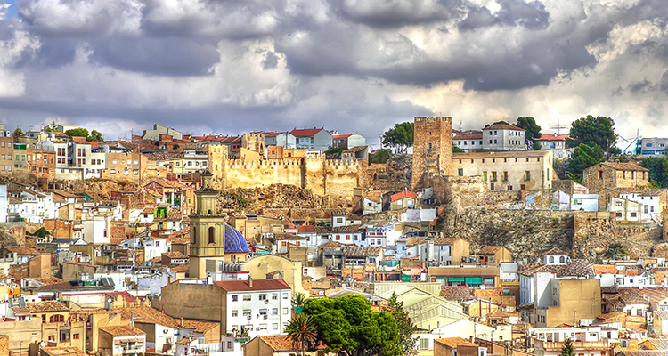
Where is it done?
La Tomatina is a festival held in the Valencian town of Buñol, Spain. Buñol is a municipality in the Valencian Community, located in the interior of the province of Valencia.

Slide 3
When is celebrated?
It is always held on the last Wednesday of August, during the week of Buñol's festivities.

Slide 4
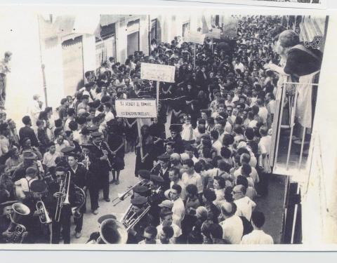
Why is it celebrated
La tomatina started with a fight between young people, in which there were vegetables incorporated. The following year some young people wanted to repeat the event but the authorities did not allow it. Therefore, the tomato funeral was held, where they carried a coffin with a giant tomato while they accompanied with funeral music. This event was a success and thanks to this Tomatina was allowed as a tradition

Slide 5
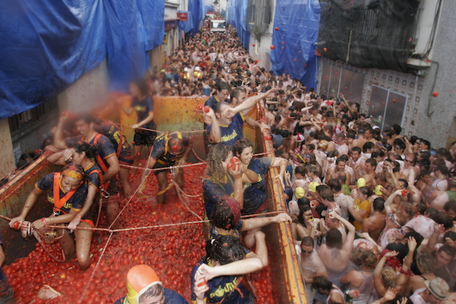
How is it celebrated?
La Tomatina starts at 10:00 a.m. with a competition that consists to catch a ham tied to the top of a stick, when someone has done it, the battle begins where around 150 tons of tomato are delivered to the participants by 6 trucks approximately.

Slide 6

Some Photos

Slide 7
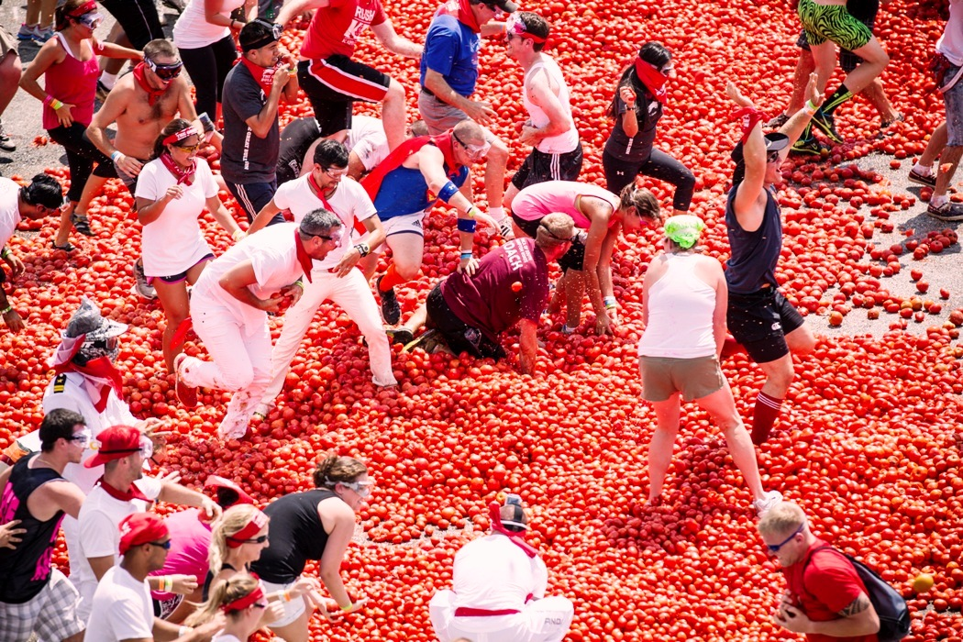

Slide 8
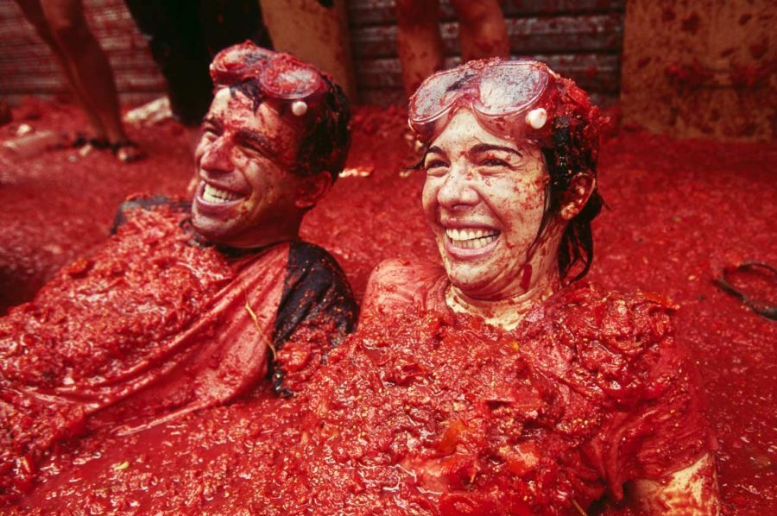

Slide 9
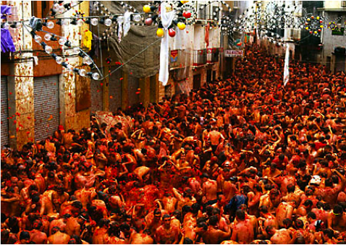

Slide 10
Creators
Alejandro Giraldo Herrera
Juan José Agudelo Estrada
ADSI 2236347
SENA
Armenia – Quindío, Colombia

Slide 11
Thank you!

